Slide 1
DATA PREPROCESSING

Slide 2
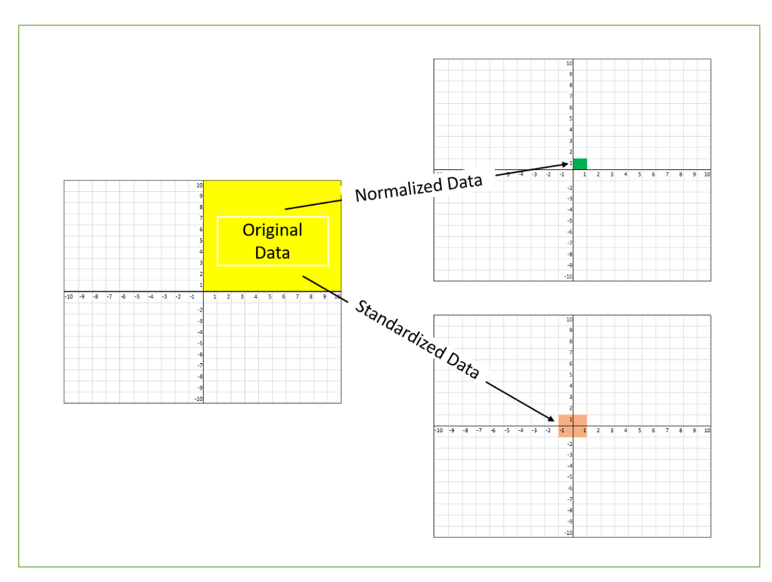
DATA PREPROCESSING

Slide 3
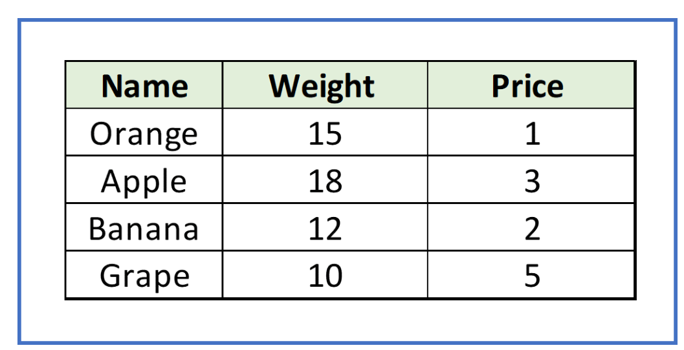
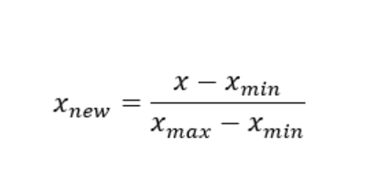
MIN MAX SCALING – REG / NEU NET.
Why Scaling
Machine learning algorithm just sees number
This method scales values between 0 and 1 [0, 1]
Sets minimum equal to zero, maximum equal to one, and all other values scaled accordingly in between
For the maximum and minimum value , what is the correct point(0 to 1)

Slide 4
STANDARDISE
Why Standardise
Standardized data is essential for accurate data analysis; it’s easier to draw clear conclusions about your current data when you have other data to measure it gains
In Standardization we transform our values such that the mean of the values is 0 and the standard deviation is 1.

Slide 5
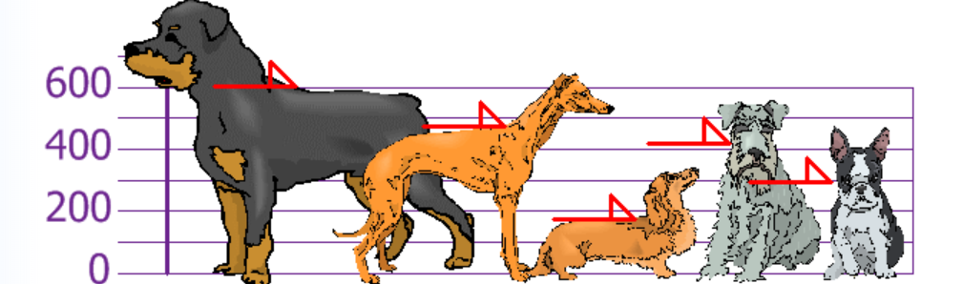
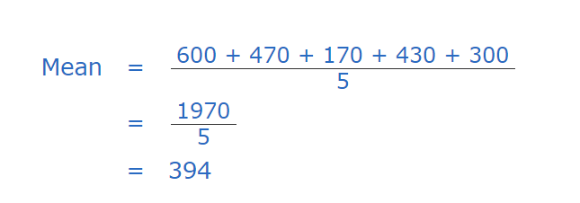
VARIANCE

Slide 6
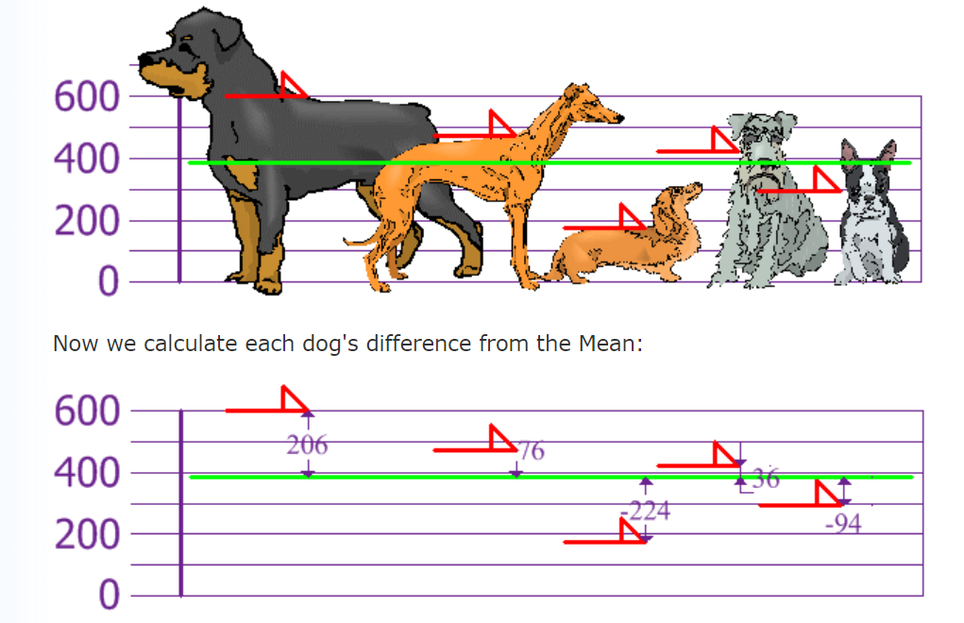
VARIANCE

Slide 7
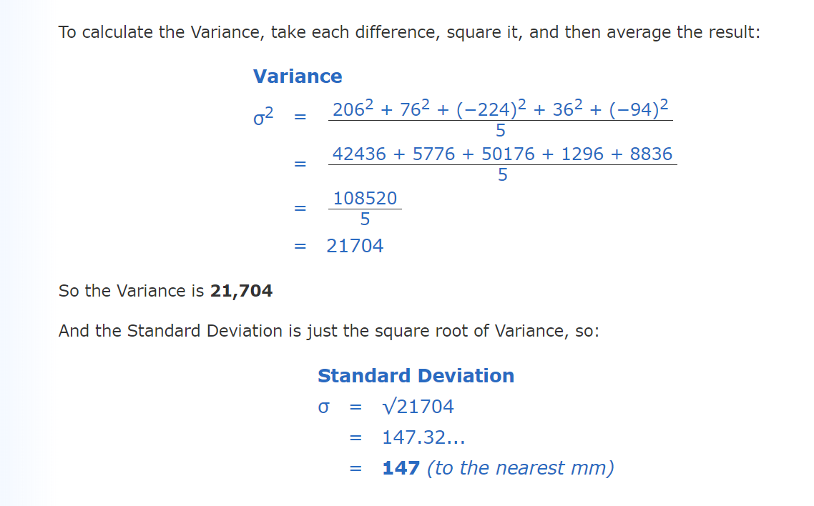
VARIANCE AND STANDARD DEVIATION

Slide 8
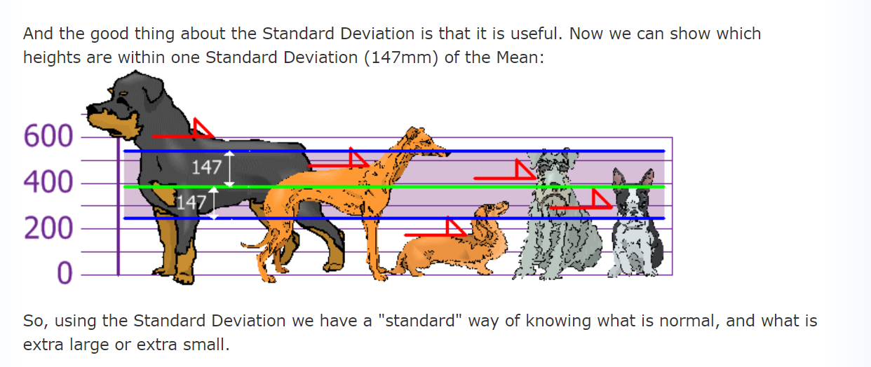
VARIANCE AND STANDARD DEVIATION

Slide 9
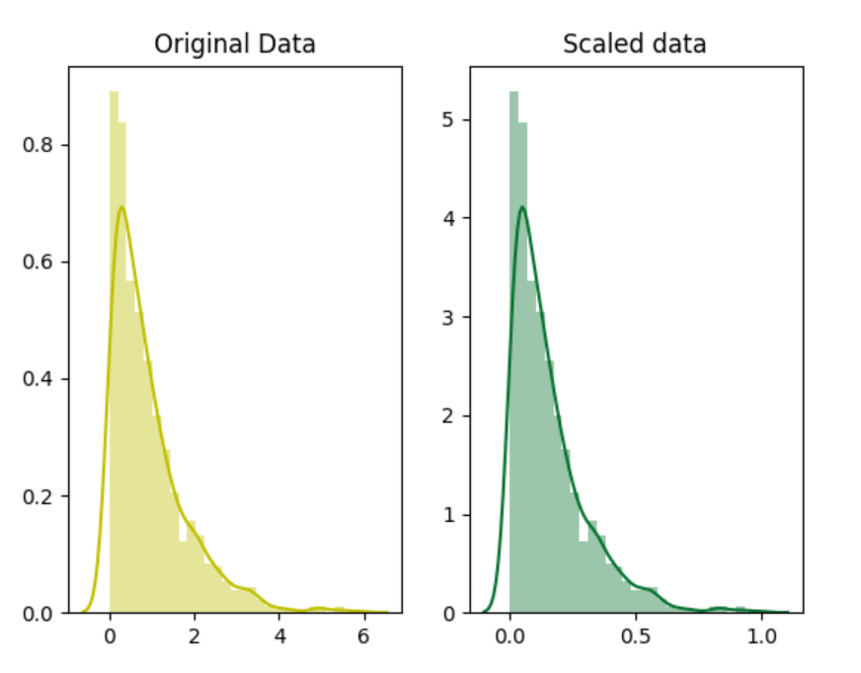
STANDARDISE

Slide 10
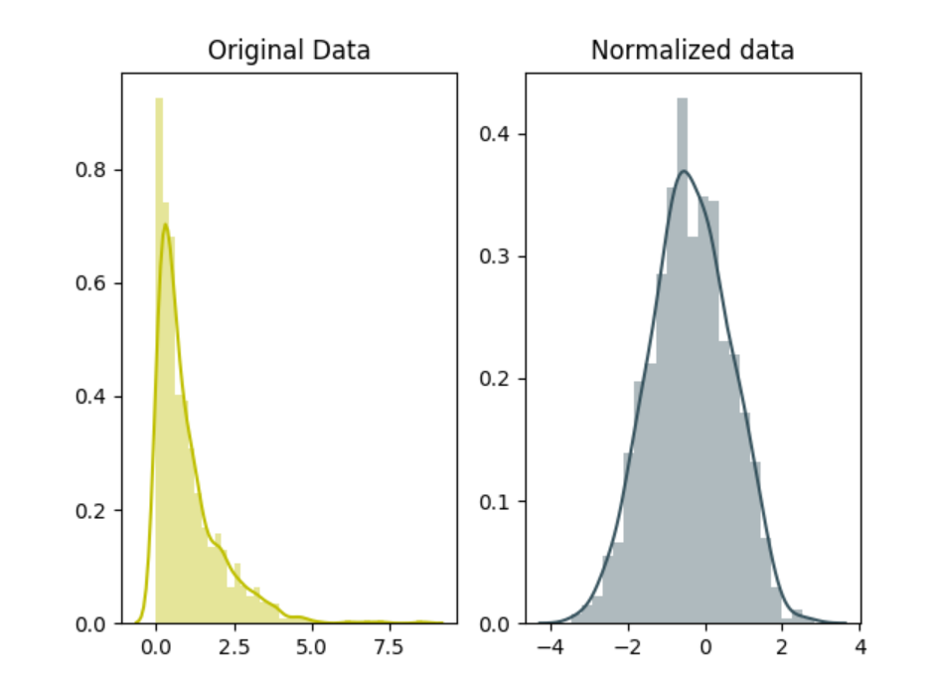
NORMALIZE

Slide 11
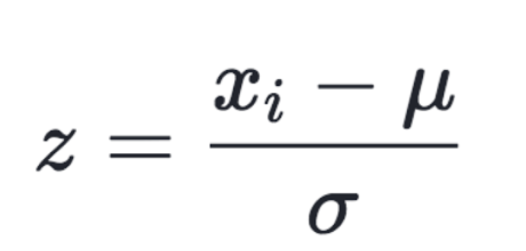
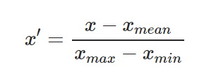
STANDARDISE VS NORMALIZE

Slide 12
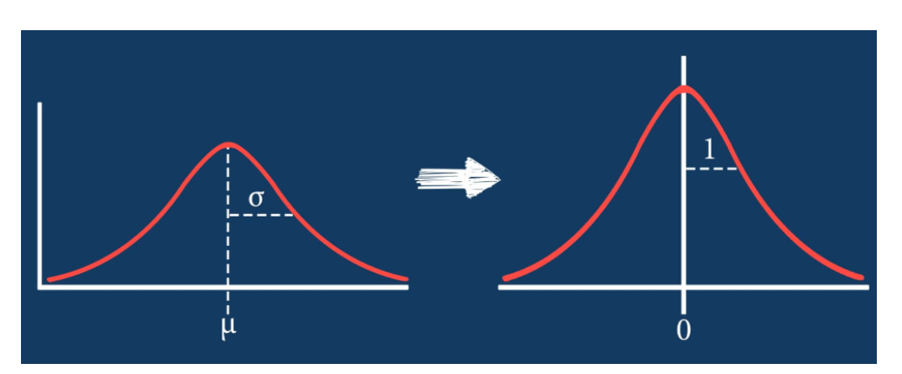
STANDARDISE

Slide 13


